Slide 1
Niagara 4
Features, compatibility & licensing

Slide 2
Topics
Niagara 4 overview
Niagara AX-Niagara 4 compatibility
Software maintenance (SMA)
Licensing

Slide 3






Cutting-edge user interface
Find, visualize data
to maximize building efficiency
Shorter integration time
Easily create secure systems
Improved developer experience
Notes:
We have a lot of cool technology that we’re going to demo today, but I wanted to spend a couple minutes to give some context about why this technology is important to our (and your) customers.
UI
Stable & Secure interface – no JAVA!
Sizzle! – Modern look & feel, reflects premium product when selling/demos
Short Integration Times – improving workflows for common tasks such as…
Device integration – templates
Graphic reuse- templates
Building Navigation for End Users – hierarchies
Finding & Visualizing Data to make good business decisions faster
Search entire system using Tags! Much easier to use than BQL and all data is available in Supervisor when a JACE® joins system
Charting has been vastly improved to create richer reports and more easily diagnose system problems
Secure Systems
Simplified UI for configuring security settings for things like managing certificates and user permissions
Finally, we want to improve the Developer Experience
Our new UI framework is based on Open Web Technologies and we’ve refactored BajaScript to be more modular and easier to use
All new features will have published APIs with documentation and examples
Semantic modeling will enable the app developer community to defined a standardized interface to interact with devices that have been integrated into Niagara

Slide 4
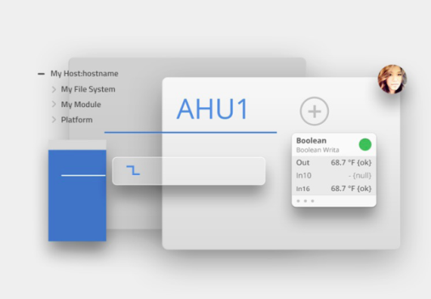
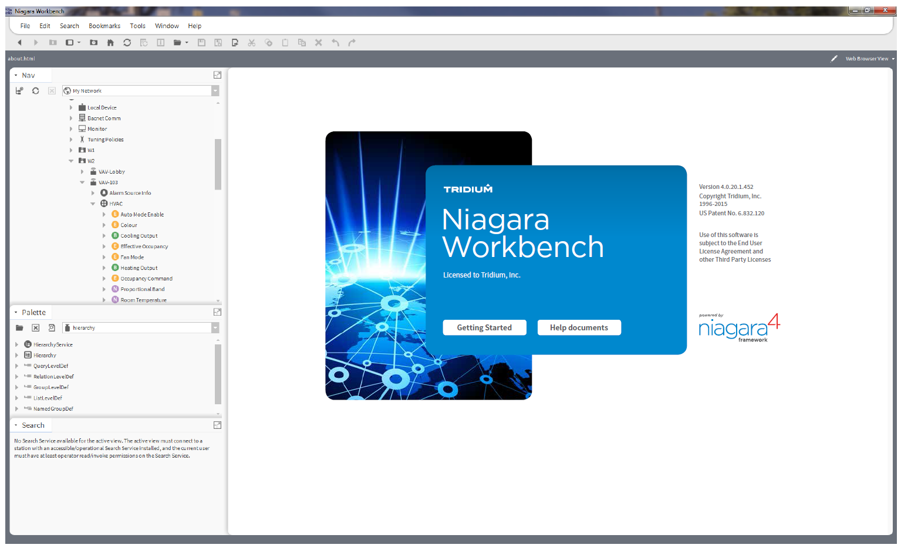
User interface
UX framework
Modern design language
    Clean and crisp
    Deliberate use of color
HTML5 technology
    Common end user views
    No browser plug-in required

Slide 5
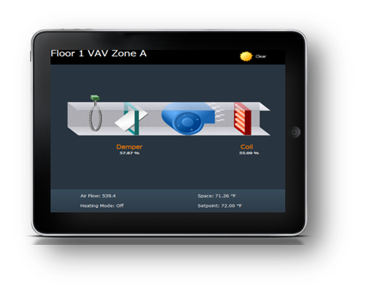
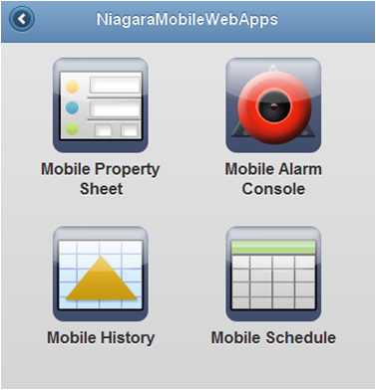
User interface
Mobile
HTML5 technology
      No native app required
Common design language
      Unified experience between
      desktop, tablet and phone

Slide 6
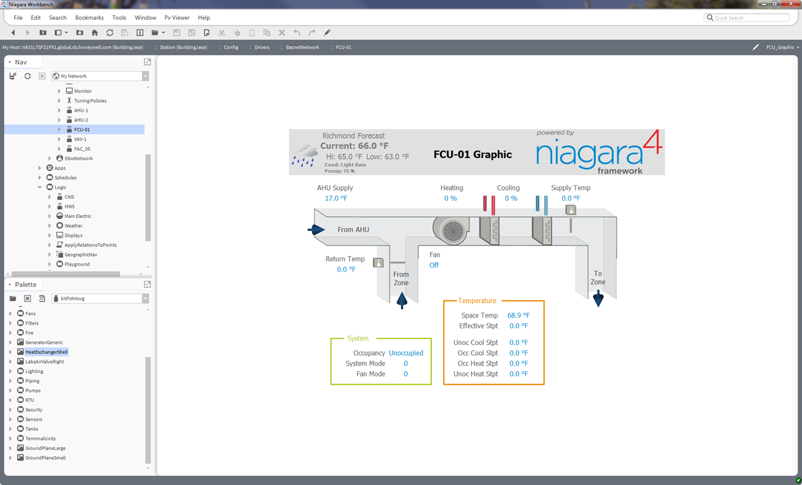
User interface
SVG Graphics Library

Slide 7
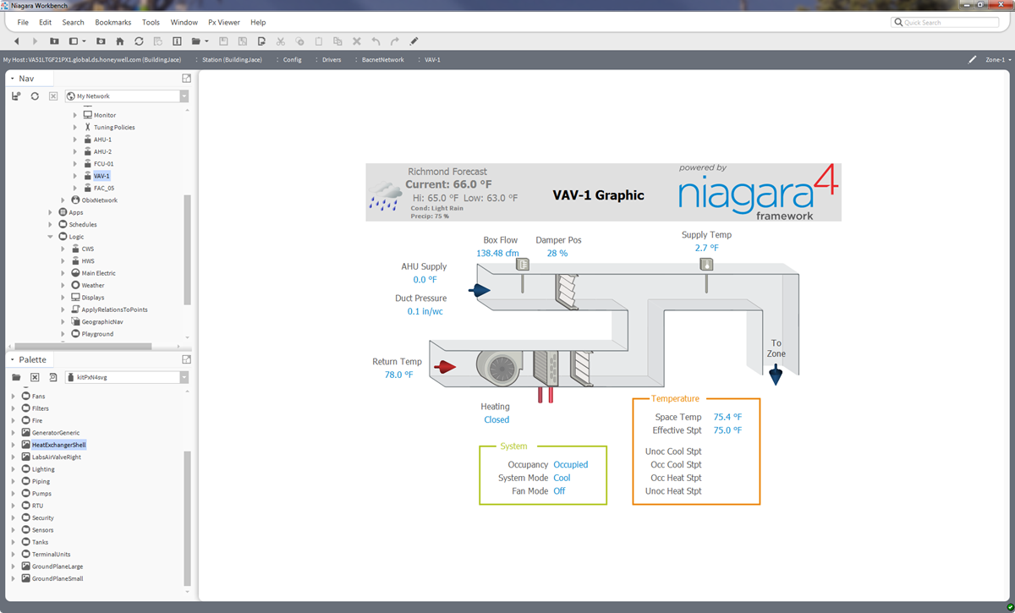
User interface
SVG Graphics Library

Slide 8
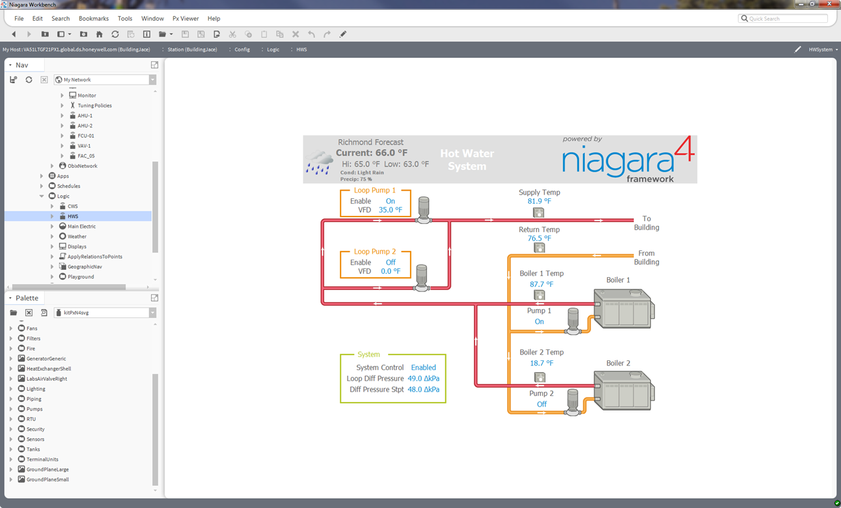
User interface
SVG Graphics Library

Slide 9
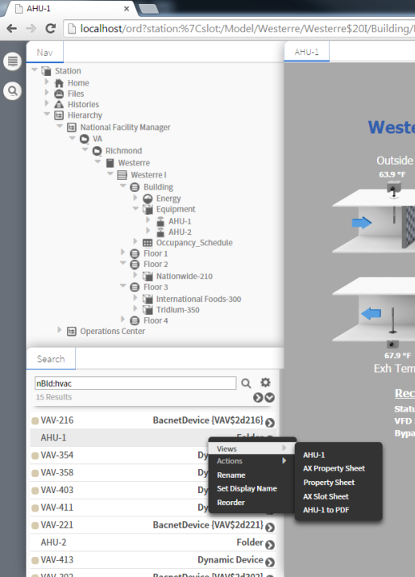
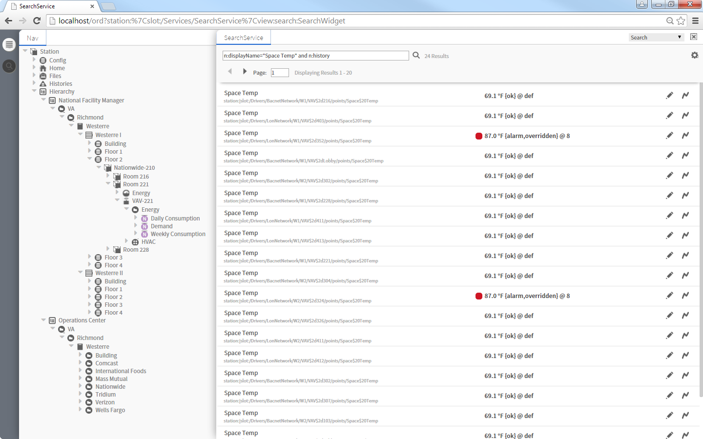
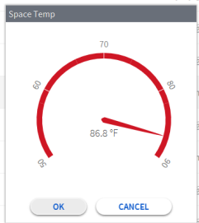
Find and visualize data
Tagging and search
Quickly search for data using tags
    Drag ‘n’ drop data into other views
    Supports any dictionary
      Niagara entities implicitly tagged
      Multiple dictionaries allowed
      Create custom dictionaries
    Supports relationships between tags
Niagara search pane

Slide 10
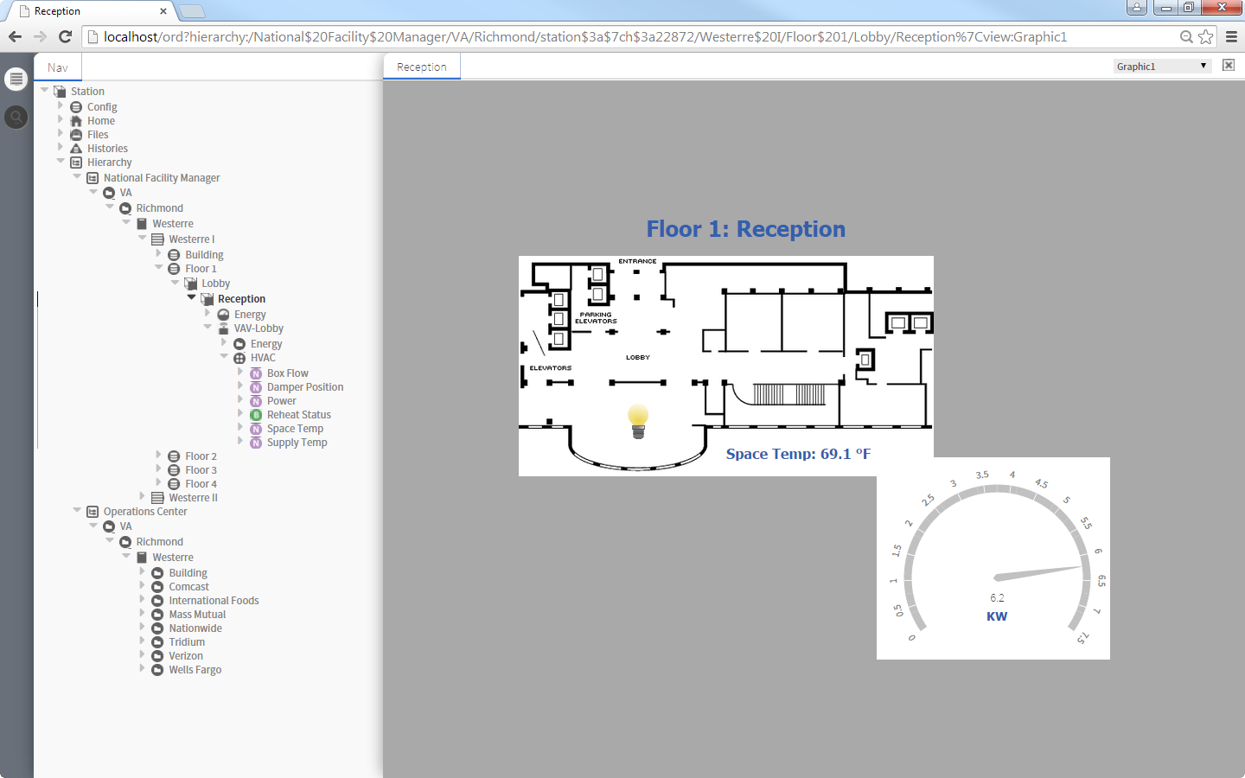
Find and visualize data
Navigation
Navigation hierarchy based on tags
    Tag relationships define structure
    Multiple hierarchies to match user role
Devices / points auto-populate
Navigation

Slide 11
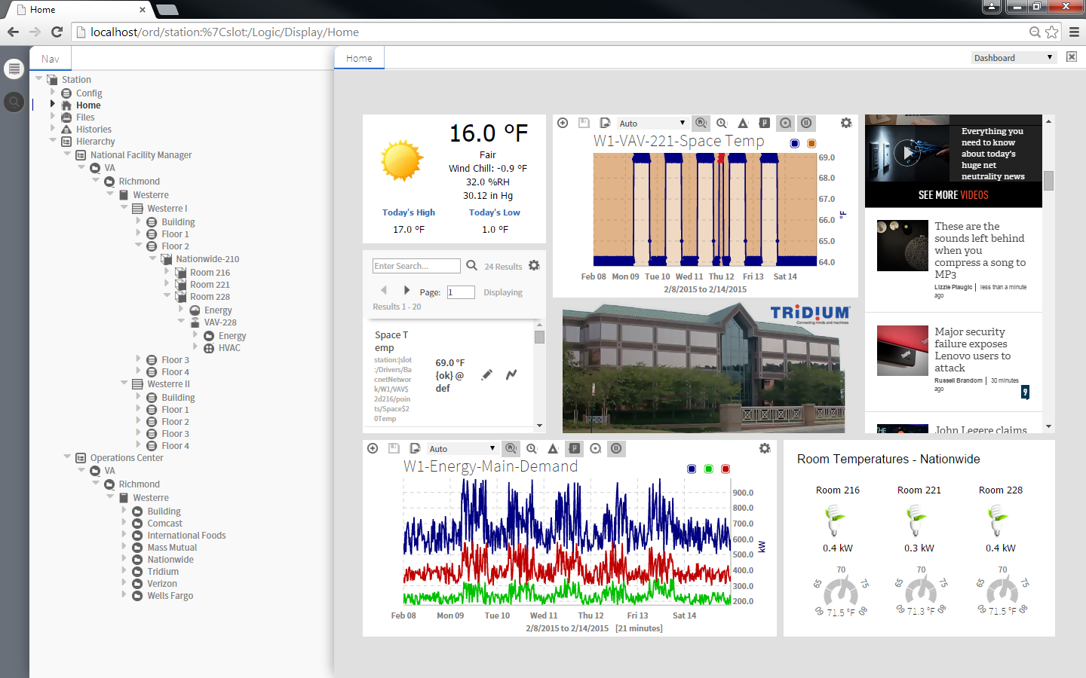
Find and visualize data
Dashboards
Drag ‘n’ drop data onto dashboard in real time
Supports web browser as a widget
Users can save custom dashboards to view later

Slide 12
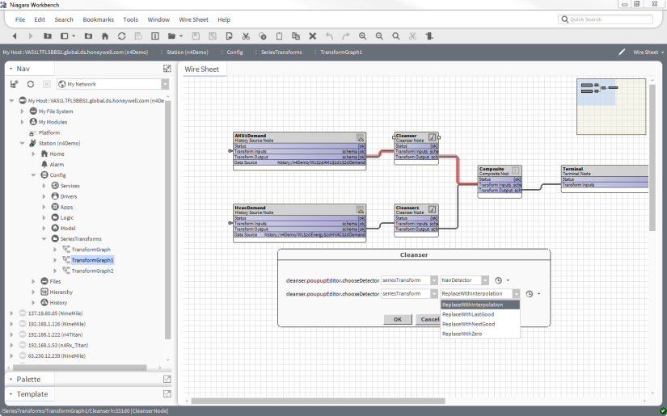
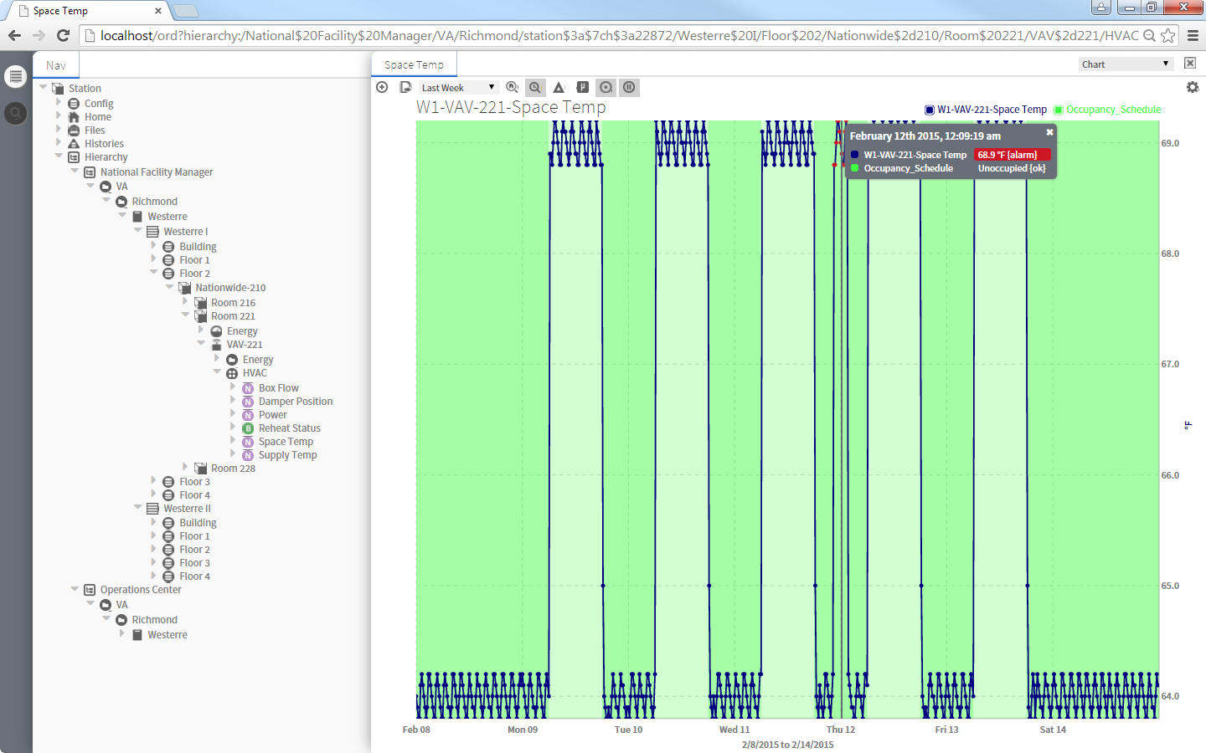
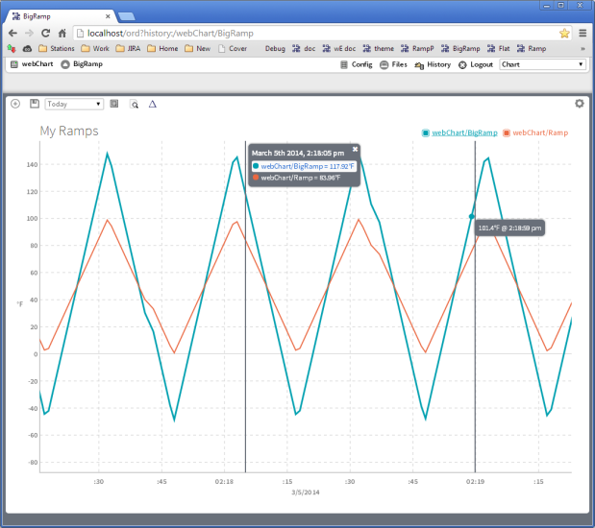
Find and visualize data
Charts
Drag ‘n’ drop data onto charts
Easily compare multiple points
Point status visible on chart
Save charts for later use
Data cleanser for handling bad data

Slide 13
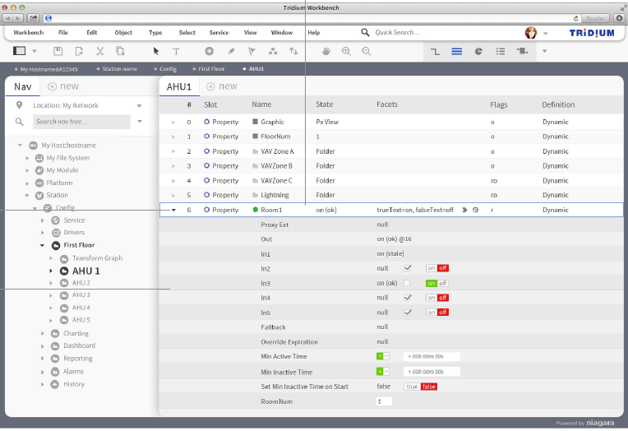
Faster integrations
Workbench improvements
Re-designed property sheet
Integrated search
Fewer clicks; more intuitive dialogs
Important data stands out

Slide 14
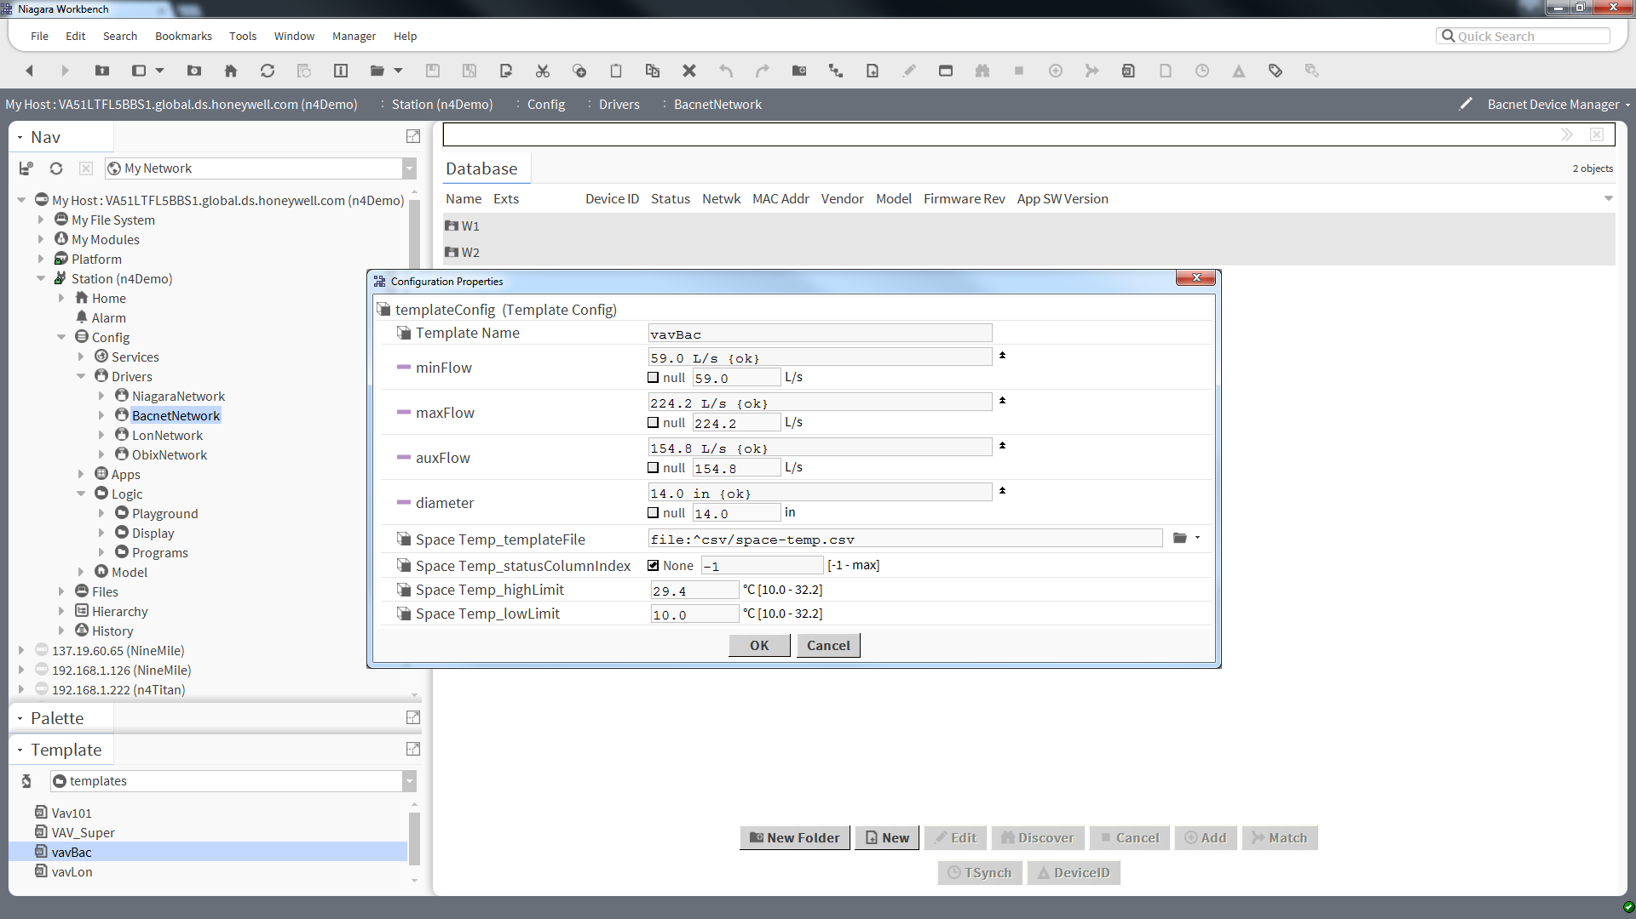
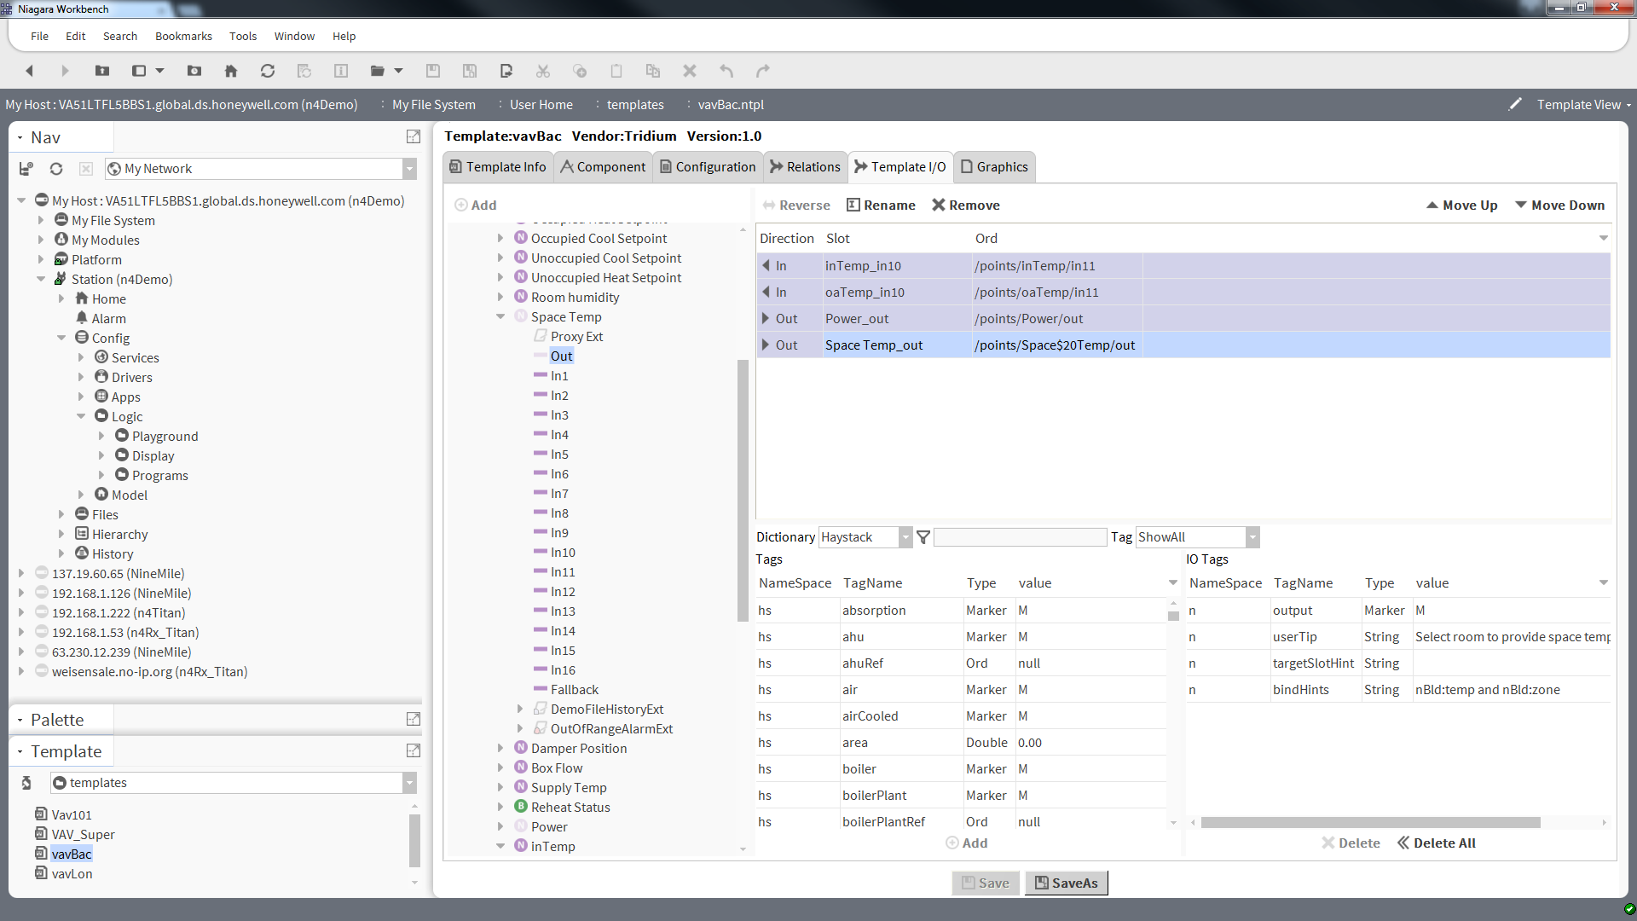
Faster integrations
Templates
Create templates for common integrations
    Tags, graphics and logic can be embedded in templates
Deploy templates to save time
    Template configuration wizard
    External links suggested
    based on tags

Slide 15
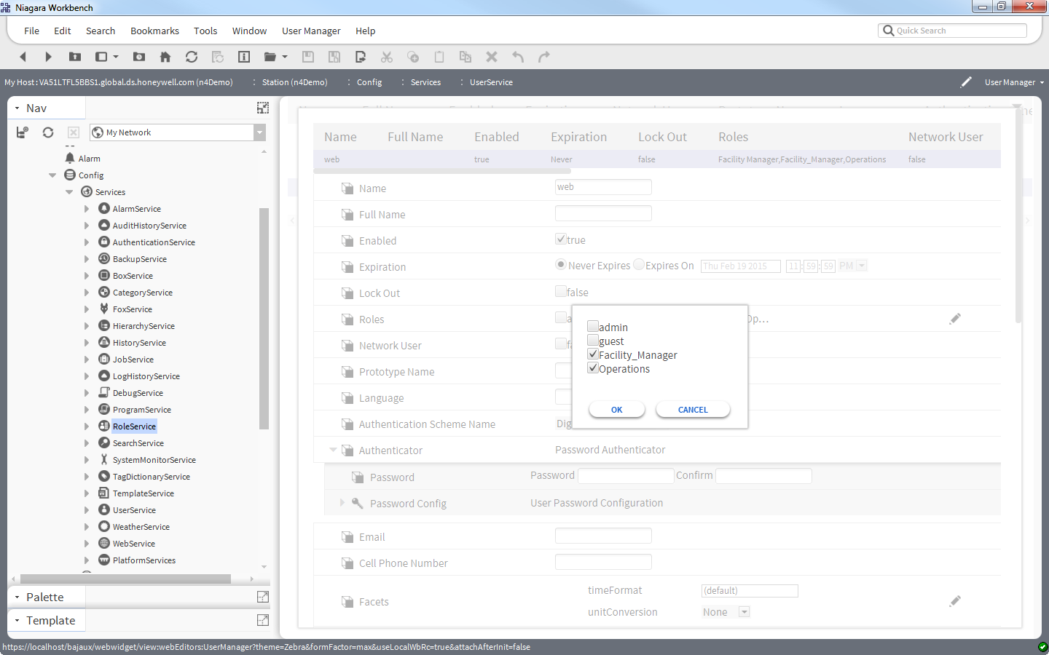
Security: new features
Tridium module code signing
    Verify module author and that code hasn’t been altered or corrupted
Role-based access control
    Manage user roles and permissions with tags

Slide 16
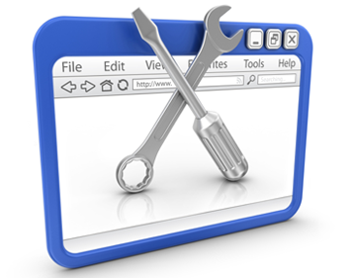
Extensible platform
Developer support
UX framework based on open web technology
    HTML5, CSS3, JSON, etc.
    BajaScript v2.0
Improved public APIs
Historian DB API
Queryable tags enables app community
Improved documentation and examples:
  https://www.niagara-community.com/articles/Product_Guide/Developer-Program-Services-Home

Slide 17
Niagara 4 Features Summary
UI / visualization enhancements | Move away from JAVA applet – convert key end user views Hierarchical navigation (via tags) New UX framework (HTML5) and design language Workbench workflow improvements Improve UI developer experience (BajaScript v2.0)
Reporting | Customizable dashboards Data cleansing capabilities Series transform improvements Advanced charting Line and bar charts Local Niagara station search/queries
Security | Role-based access control Code signing
Device management | Device templating Tagging
Licensing | Capacity licensing
JACE® 8000 support | WiFi USB backup and restore
Niagara AX migration | Station migration tool
JACE is a registered trademark of Tridium Inc.

Slide 18
Niagara AX-Niagara 4 compatibility
  Network compatibility
    Systems can have mix of Niagara AX and Niagara 4 JACE® controllers
    Niagara network will work between Niagara AX and Niagara 4
      v3.6u4, v3.7u1, v3.8R required
  Station conversion tool
    Tridium will offer tool to convert Niagara AX stations to Niagara 4 stations
    3rd party modules can be converted when vendors provide Niagara 4
    versions of their content
    Converted stations may not work without updated 3rd party modules
  Developer APIs
    Rare opportunity to make breaking changes to Niagara APIs
    Developers will have to re-compile/re-factor their modules for Niagara 4
    Most modules will only require minor re-factor for developers
    N-driver driver framework supported – older driver frameworks deprecated
  Hardware
    Runs on any JACE w/ hotspot VM (J3E, J6, J6E, J7)
    Runs on the JACE 8000

Slide 19

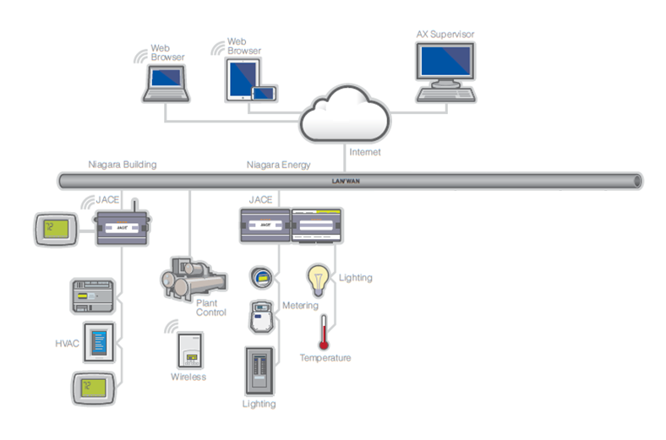
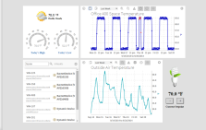


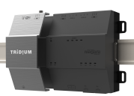
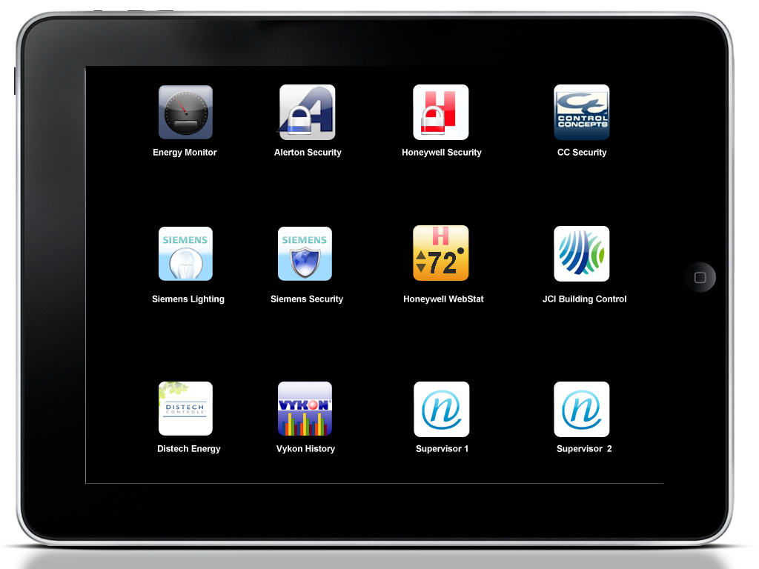
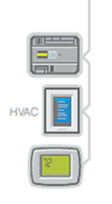
Niagara AX to Niagara 4 upgrade path
Notes:
Migration Tool
Niagara 4 will come with a migration tool to move existing stations from AX to Niagara 4
Mixed System Support
Station to Station Compatibility
Existing JACE Support
Existing platforms that can run the hotspot VM are expected to move forward to Niagara 4
Titan on 3.8
The subsequent update to 3.8 following the release of N4 will include hardware support for the Next generation JACE
AX Long term supported version

Slide 20

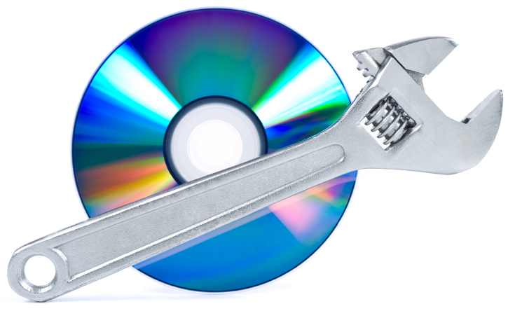
Software maintenance
Program summary
18 months included with every license (additional years can also be purchased up front)
Gap charges apply if SMA purchases after expiration (5-year max)
All update builds, patches and upgrades are provided as part of SMA
Value propositions
Many end users explicitly ask for a maintenance program to reduce risk
Distributors no longer worry about out-of-date versions sitting in stock
System integrators can add SMA to service programs – additional value
Support period for Niagara AX
Standard release: 4 years from release
Long-term release: 7 years from release
  Niagara AX v3.8 is designated a long-term release
Tech support available until product EOL

Slide 21
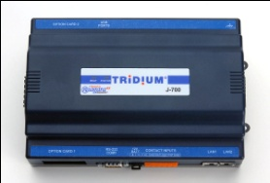
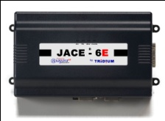
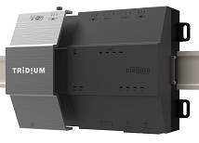
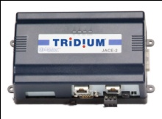
Simple capacity-based licensing
Niagara AX portfolio:
3 hardware platforms
Niagara 4 portfolio:
1 hardware platform: JACE ® 8000
JACE 7
(~200 devices)
8200
(200 devices)
JACE 6E+Mem
(~80 dev)
8100
(100 devices)
Software license
JACE 6E
(~40 dev)
8025
(25 devices)
Software license
8010
(10 devices)
JACE 3E+Mem
(~20 dev)
Software license
8005
(5 devices)
JACE 3E
(~10 dev)
Drivers:
Ad hoc
BACnet
LON
Drivers:
Standard included
Special – Ad hoc
BACnet
LON
Modbus
KNX
Modbus
KNX
SNMP
CCN
SNMP
CCN

Slide 22
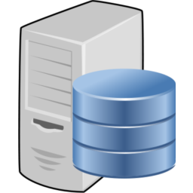
Simple capacity-based licensing
Niagara AX portfolio:
Ad hoc drivers
Niagara 4 portfolio:
Consistent capacity packs
Supervisor-UNL
Supervisor-UNL
JACES managed
Supervisor-100
Supervisor-100
JACES managed
Supervisor-10
Supervisor-3
Supervisor-3
Supervisor-2
Add JACEs or devices as needed
SoftJace
Supervisor-1
Supervisor-0
WorkBench
Devices managed
Drivers:
Ad hoc
500pt packs
BACnet
LON
BACnet
LON
Drivers:
Standard IP included
Special IP – Ad hoc
10, 25, 50, 100 device packs (50pts / device)
Modbus
KNX
Modbus
KNX
SNMP
DB drivers
SNMP
DB drivers

Slide 23
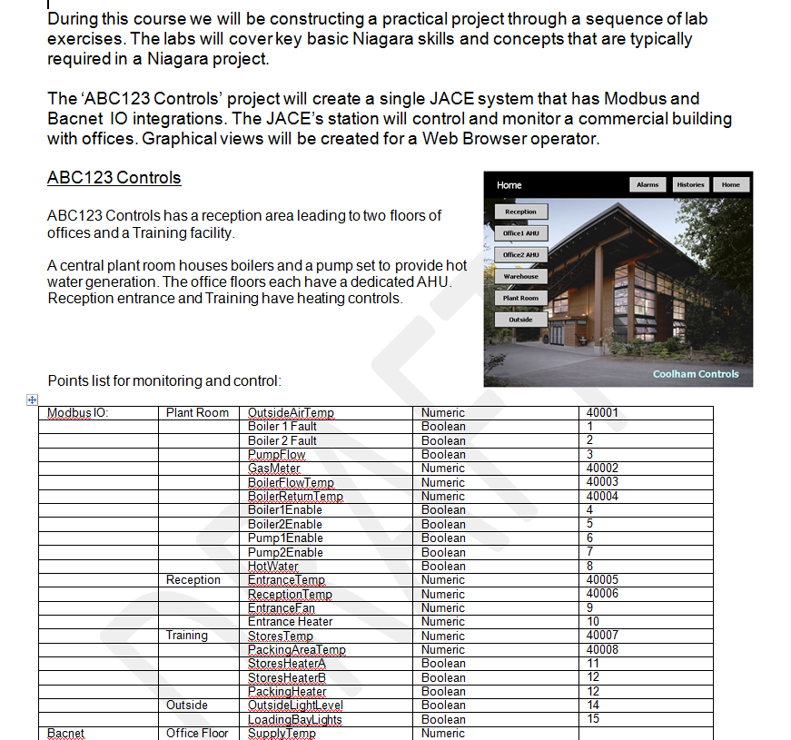
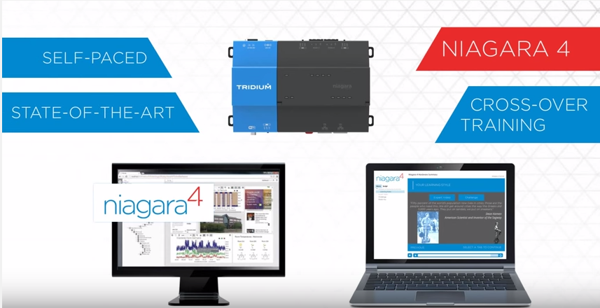
Niagara 4 Certification Training
Certification Training is a prerequisite for purchasing Niagara 4
Several options based on credentials and role within the organization:
    Niagara AX certified: Niagara 4 Cross-Over Web-based training and certification course; self-paced, completed online anytime, anywhere (Part # TRN-DLS-N4-WBT)
    New users or not certified: Niagara 4 Technical Certification Program (TCP); 5-day, instructor-led program offered worldwide this fall (Part # TRN-CRS-N4-TCP)
    Coming soon: Niagara 4 Developer Training and Certification for those who are Niagara AX certified. Program focuses on new, improved capabilities for developing on Niagara 4. Additionally, Developer Training for new developers.

